Slide 1

Organizational Behavior
(MGT-502)
Lecture-26

Slide 2
Summary of
Lecture-25

Slide 3
Political Behavior in Organizations
Organizational Politics - the use of power and influence in organizations
Political Behavior - actions not officially sanctioned by an organization that are taken to influence others in order to meet one’s personal goals
Notes:
14

Slide 4
Types of Organizational Politics
Managing
impressions
Attacking and
blaming
Types of
Organizational
Politics
Creating
obligations
Controlling
information
Cultivating
networks
Forming
coalitions

Slide 5
Conditions for Organizational Politics
Personal
Characteristics
Scarce
Resources
Conditions
Supporting
Organizational
Politics
Tolerance of
Politics
Complex and
Ambiguous
Decisions

Slide 6
Managing Political Behavior
Maintain open communication
Clarify performance expectations
Use participative management
Encourage cooperation among work groups
Manage scarce resources well
Provide a supportive organizational climate
Notes:
17

Slide 7
Managing Political Behavior
Encourage
Discourage
Relationships
Negativity
Negotiation
Self-Interest
Compromise
Destructive
Behavior
Notes:
13

Slide 8
Ethical Guidelines for Political Behavior
Unethical
Ethical
Question 1
Is the action
motivated by
self-serving
interests which
exclude the
goals of the
organization?
Yes
Question 3
Is the political
activity fair
and equitable?
Yes
No
No
Unethical
Yes
Question 2
Does the political
action respect
individual rights?
No
Unethical

Slide 9
Today’s Topics

Slide 10
Conflict Defined
The process in which one party perceives that its interests are being opposed or negatively affected by another party.

Slide 11
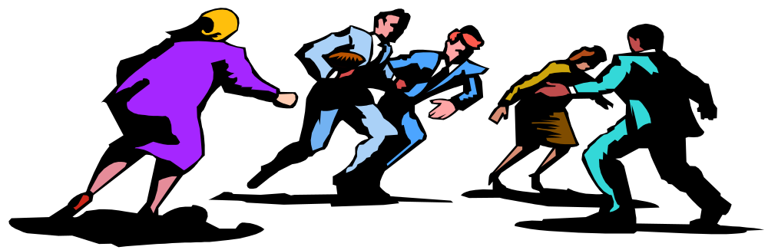
Definition - Conflict
"a process which begins when one party perceives that the other is frustrated, or is about to frustrate, some concern of his (or her).

Slide 12
Definition of Conflict
Perceived by the parties
Parties are in opposition to one another
At least one party is blocking the goal attainment of the other party
Goals can be tangible or psychological
  Money
  Task Achievement
  Happiness

Slide 13

Types of Conflict
Task conflict
Conflict over content and goals of the work
Relationship conflict
Conflict based on interpersonal relationships
Process conflict
Conflict over how work gets done

Slide 14
Nature of Organizational Conflict
Conflict - any situation in which incompatible goals, attitudes, emotions, or behaviors lead to disagreement or opposition between two or more parties
Functional Conflict - a healthy, constructive disagreement between two or more people
Dysfunctional Conflict - an unhealthy, destructive disagreement between two or more people
Notes:
2

Slide 15
Levels and Types of Conflict
Level of conflict
Type of conflict
Organization
Within and between organizations
Group
Within and between groups
Individual
Within and between individuals

Slide 16
Forms of Conflict in Organizations

Slide 17
Interorganizational Conflict - conflict that occurs between two or more organizations
Intergroup Conflict - conflict that occurs between groups or teams in an organization
Interpersonal Conflict - conflict that occurs between two or more individuals
Intrapersonal Conflict - conflict that occurs within an individual
Notes:
8

Slide 18
Interrole Conflict - a person’s experience of conflict among the multiple roles in his/her life
Intrarole Conflict - conflict that occurs within a single role, such as when a person receives conflicting messages from role senders about how to perform a certain role
Person-role Conflict - conflict that occurs when an individual is expected to perform behaviors in a certain role that conflict with his/her personal values
Notes:
8

Slide 19
Globalization & Conflict
Cultural differences & individual differences increase the potential for conflict
Notes:
6

Slide 20
The Conflict Process
Conflict
Perceptions
Sources of
Conflict
Manifest
Conflict
Conflict
Outcomes
Conflict
Emotions

Slide 21
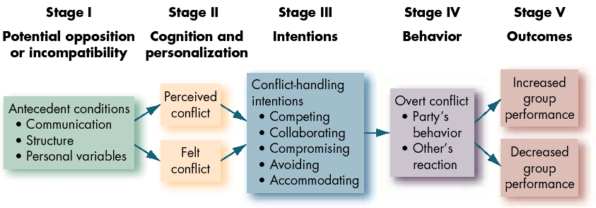
The Conflict Process

Slide 22
People factors that affect the development of the conflict
Needs and wants
Self-concept
Past experience
Health
Notes:
11
10

Slide 23
Other factors that affect the development of the conflict
Management culture
Stage of development of the organization
Organizational structures
State of business
Weather
Notes:
12
11

Slide 24
Is Conflict Bad?
Traditional View: Bad
Human Relations: Good
Interactionist: Depends

Slide 25
Transitions in Conflict Thought
Traditional
View
Human
Relations
View
Interactionist
View

Slide 26
Traditional
Conflict is bad & should be avoided
Results from lack of openness & trust
Evidence of a failure in management
The “Common Sense” view of conflict

Slide 27
Human
Relations
Conflict is a natural occurrence
We should accept conflict

Slide 28
Interactionist
The view of current Conflict Theory
Conflict should be encouraged & managed
Brings life, creativity & synergy

Slide 29
Is Conflict Good or Bad?
Functions of Conflict
  Synergy
  Promotion of change
  Promotes goal achievement
Dysfunctions of Conflict
  Wasted time & energy
  Stress
  Detracts from the goal of the group

Slide 30
Organizational Conflict Outcomes
Dysfunctional outcomes
  Diverts energy and resources
  Encourages organizational politics
  Encourages stereotyping
  Weakens knowledge management
Potential benefits
  Improves decision making
  Strengthens team dynamics

Slide 31
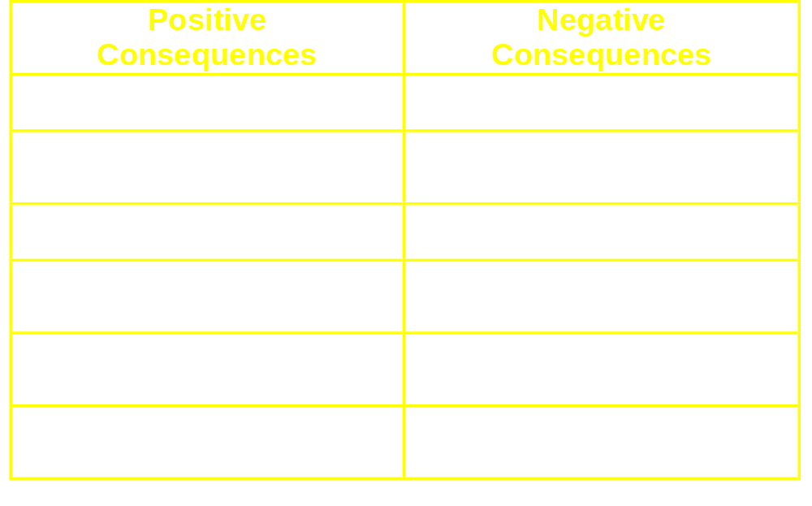
Consequences of Conflict
Notes:
4

Slide 32
Sources of Conflict
Goal
Incompatibility
Goals conflict with goals of others
Different Values
and Beliefs
Different beliefs due to unique background, experience, training
Caused by specialized tasks, careers
Explains misunderstanding in cross-cultural and merger relations

Slide 33
Sources of Conflict
Three levels of interdependence
Goal
Incompatibility
Pooled
Resource
Different Values
and Beliefs
A
B
C
Task
Interdependence
Sequential
A
B
C
Reciprocal
A
B
C

Slide 34
Sources of Conflict
Goal
Incompatibility
Different Values
and Beliefs
Task
Interdependence
Scarce
Resources
Increases competition for resources to fulfil goals
Ambiguity
Lack of rules guiding relations
Encourages political tactics

Slide 35
Sources of Conflict
Goal
Incompatibility
Different Values
and Beliefs
Task
Interdependence
Lack of opportunity
  --reliance on stereotypes
Lack of ability
  -- arrogant communication heightens conflict perception
Lack of motivation
  -- conflict causes lower motivation to communicate, increases stereotyping
Scarce
Resources
Ambiguity
Communication
Problems

Slide 36
Causes of conflict.
  Vertical conflict.
    Occurs between hierarchical levels.
  Horizontal conflict.
    Occurs between persons or groups at the same hierarchical level.
  Line-staff conflict.
    Involves disagreements over who has authority and control over specific matters.

Slide 37
How can conflict be managed successfully?
The issue of “who wins?”
  Lose-lose conflict.
    Occurs when nobody gets what he or she wants.
    Avoidance, accommodation or smoothing, and compromise are forms of lose-lose conflict.
  Win-lose conflict.
    One part achieves its desires at the expense and to the exclusion of the other party’s desires.
    Competition and authoritative command are forms of win-lose conflict.

Slide 38
The issue of “who wins?” — cont.
  Win-win conflict.
    Both parties achieve their desires.
    Collaboration or problem solving are forms of win-win conflict.

Slide 39
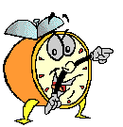
Let’s stop it here

Slide 40
Summary

Slide 41
Definition - Conflict
"a process which begins when one party perceives that the other is frustrated, or is about to frustrate, some concern of his (or her).

Slide 42
Types of Conflict
Task conflict
Conflict over content and goals of the work
Relationship conflict
Conflict based on interpersonal relationships
Process conflict
Conflict over how work gets done

Slide 43
Levels and Types of Conflict
Level of conflict
Type of conflict
Organization
Within and between organizations
Group
Within and between groups
Individual
Within and between individuals

Slide 44
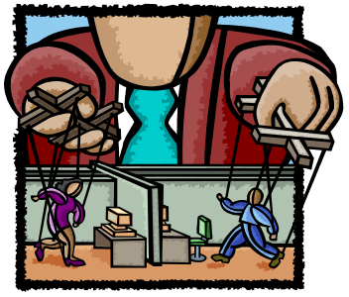
Sources of conflict
Organizational hierarchy
Competition for scarce resources
Self-image & stereotypical views of others
Differing goals & objectives
Failures & resultant blame fixing
Poor coordination of activities

Slide 45
Is Conflict Bad?
Traditional View
Human Relations
Interactionist

Slide 46
Next….

Slide 47
Organizational Behavior
(MGT-502)
Lecture-26

